Slide 1
Living in a Quotient Space
Marisa Hughes
Cornell University

Slide 2
Outline
Flatland and Surfaces
Orientability
Higher Dimensions
Homology
Geometry
Linear Quotient Spaces
Current Research

Slide 3
What is it like to live in Flatland?
The book Flatland chronicles the life of A. Square, who resides in a 2-dimensional world. His compatriots are other polygons and lines.
Arthur describes how all he can see are line segments and points; there is nothing else in his experience.
What does Arthur really know about his world? He cannot see it from the ‘outside’ like we can.
He believes that his world is completely flat, but is that necessarily so?
What are the other possibilities, and how could he ever determine which is the true shape of his home?

Slide 4
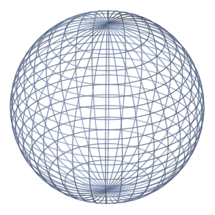
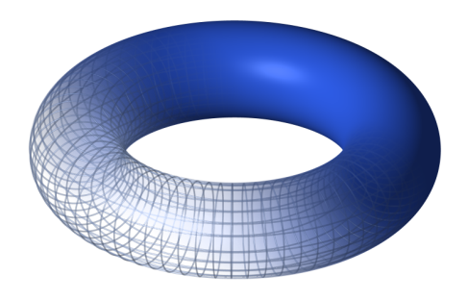
Surfaces
A surface is a space that appears to be perfectly flat and without borders to its inhabitants.
Surfaces can be more rigourously defined as being
2-manifold: a space that is locally homeomorphic to R^{2.}
(a homeomorphism is a continuous function with a continuous inverse)
Examples:

Slide 5
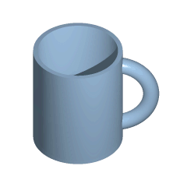
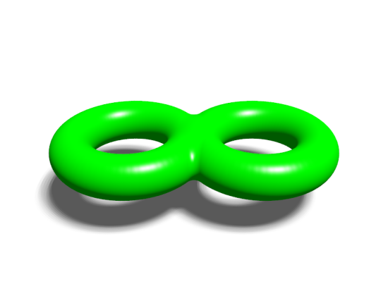
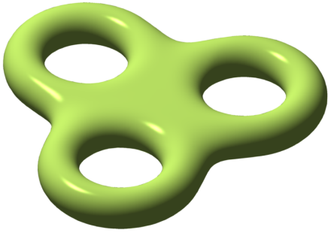
What Other Surfaces Are There?
Well, we can keep sticking together more and more copies of the torus to get an infinite number of surfaces:
, , , , ∙∙∙∙

Slide 6
What Other Surfaces Are There?
Well, we can keep sticking together more and more copies of the torus to get an infinite number of surfaces:
, , , , ∙∙∙∙
In fact, this sequence lists all the orientable surfaces, up to homeomorphism ( a continuous function with a continuous inverse).
For now, we will be topologists, and think of any stretchings as being the same surface; do NOT tear or mash.

Slide 7

From vihart.com

Slide 8
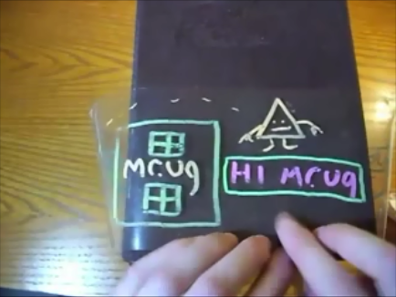
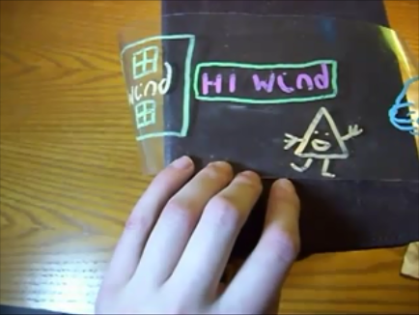
Why is Wind having so much trouble catching Mr.Ug while he’s at home?
Wind leaves Mr.Ug a message
And finds a message from him in return!

Slide 9
The perils of living on a Möbius band: flipping over without realizing it
The story continues to follow the adventures of Wind as Mr.Ug leaves her progressively more mysterious messages. For the conclusion of this video, and other marvelous mathematical movies, please search for Vihart on youtube or google.

Slide 10
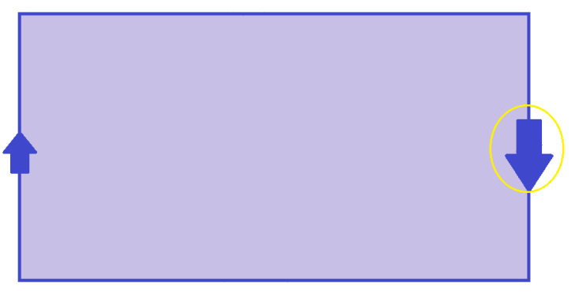
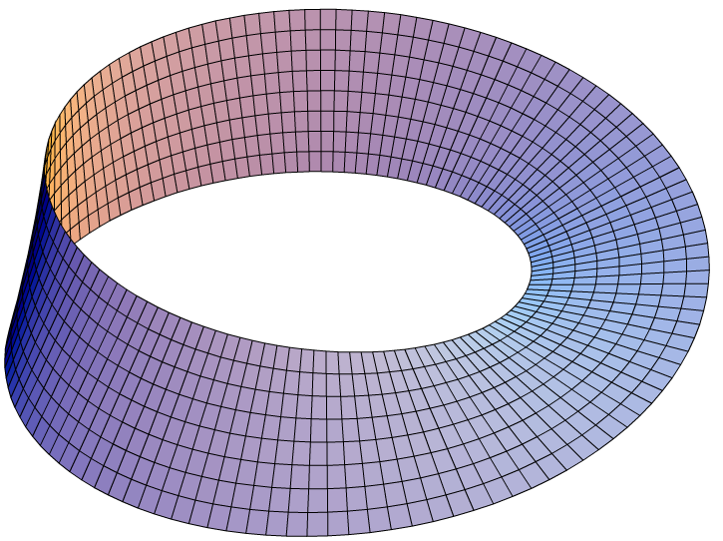

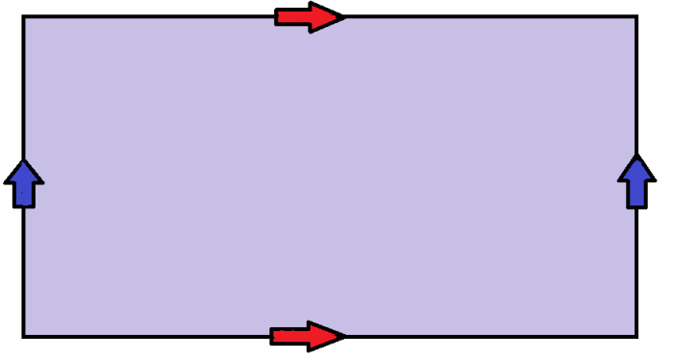
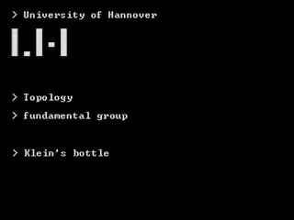
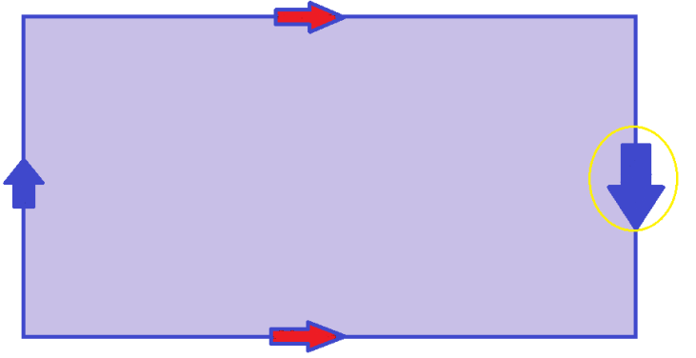
Möbius Band
Torus
Klein Bottle

Slide 11
On Orientability
A space is non-orientable if it is somehow twisted, so that circumnavigating the space can flip you upside-down. Non-orientable surfaces all have Mobius bands hidden inside them.
As a result, we’ve only listed half of all the surfaces. For each orientable surface, there is a nonorientable surface that is built in a similar manner, but includes a Mobius Strip. Combining the surfaces we’ve discussed with their non-orientable counterparts yield every possible surface up to homeomorphism
But if we are living on a 2-manifold, how can we tell which one?

Slide 12
On Orientability
A surface is non-orientable if it contains a Möbius band; circumnavigating the space can flip you upside-down.
As a result, we’ve only listed half of all the surfaces up to homeomorphism. For each orientable surface, there is a corresponding non-orientable surface.
Combining our earlier list with a parallel list of non-orientable surfaces yields all possible surfaces up to homeomorphism.
What about other manifolds???

Slide 13
To Infinity, and Beyond!!!
(manifolds in higher dimensions)
An n-manifold is a locally homeomorphic to R^{n}
The 3-sphere is the set of all points of distance 1 from the origin in R⁴ i.e. { (a, b, c, d) ε R⁴ | a² + b² + c² + d² = 1 }
The 3-sphere is an example of a 3-manifold.
Unfortunately, picturing 3-manifolds can be a mind-bending task! We might need a little help…

Slide 14
Imagining Higher Dimensions
The following is a clip from Flatland: The Movie. Arthur has just had an unusual dream in which he met inhabitants of Pointland and Lineland. He was unable to convince them that reality is two-dimensional. What fools!
Here he meets his three-dimensional visitor for the first time. Unfortunately, Arthur can only see what lies in the plane of Flatland, so this meeting goes a bit poorly.
As you watch the clip….
-Notice the apparent magical powers of the visitor
-Try to imagine yourself meeting a fourth dimensional visitor

Slide 15
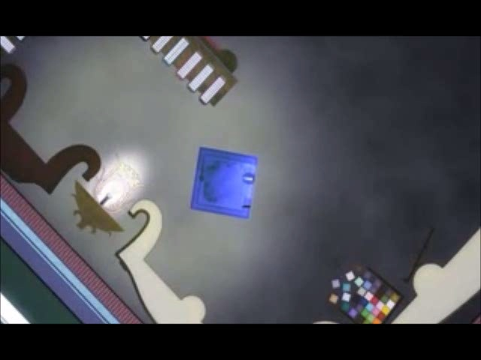
An excerpt from Flatland: The Movie(Flat World Productions, 2007)

Slide 16
Picturing 3-Spheres and Hypercubes
Just as Spherius described himself as the union of infinitely many circles, the 3-sphere is a union of infinitely many 2-spheres of varying size in parallel.
It may be easier, by analogy, to picture a hypercube, which is homeomorphic to the 3-sphere.
What does a hypercube look like?
How would we describe a cube to a flatlander?

Slide 17
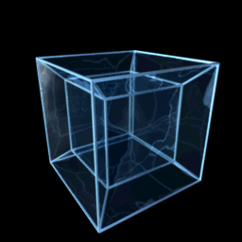
Imagining the Hypercube
This is a projection, or shadow,
of a rotating hypercube in three
dimensional space. Notice how
the inner and outer cube exchange
places as the hypercube spins.
While these cubes appear to differ
in size, they are really the same in
4-space.
Also, all angles are right angles

Slide 18
Another 3-manifold
Picture a solid 3-dimensional cube, such as the interior of this room (including it’s inhabitants).
In the same manner as we constructed the torus by gluing together opposite sides of the square, imagine that the opposite sides of the are glued together.
The resulting 3-manifold is called the 3-Torus.
What would living in a 3-Torus be like?
Are you so sure you don’t? Where might A.Square live?

Slide 19
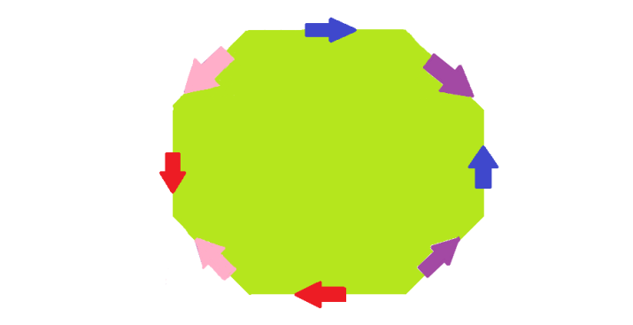
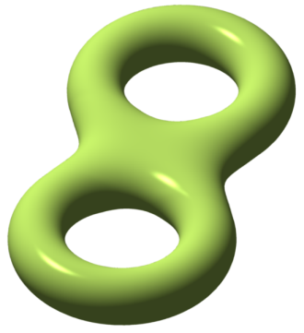
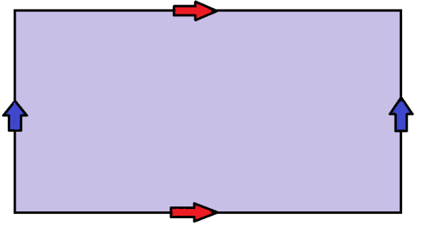
Telling topology apart: counting holes
The Torus (genus 1)
Has one component
Has two different ways to circumnavigate.
Has one pocket for air
The Double Torus (genus 2)
Has one component
Has four different ways to circumnavigate.
Has one pocket for air
By “different ways to circumnavigate”, we mean you cannot continuously shift from one loop around to the other.
= =

Slide 20
Circles are the key! Using Loops to Count Holes.
.
Two loops in a space are considered homotopic if one can be deformed into the other without leaving the space or breaking apart the loop.
Imagine wrapping rubber bands around our surface that we can stretch and slide as much as we like.
If a rubber band can be collapsed all the way down to a point, then it does NOT go around a hole and we don’t want it to appear in our homology: the measure of holes.
H₀(Double Torus) = Z
H₁(Double Torus) = Z × Z × Z × Z
H₂(Double Torus) = Z
H₀(Torus) = Z
H₁(Torus) = Z × Z
H₂(Torus) = Z
H₀(a space) describes the number of connected components
H₁ (orientable surface): 1 copy of Ζ for each distinct non-contractible loop (1-hole)
H₂( orientable surface) 1 copy of Z for each pocket for stuffing (2-hole)

Slide 21
What is the homology of the Torus?
Q: How many truly distinct loops are there around the torus?
A: There is a one-to-one correspondence between loops around the torus (up to homotopy) and elements of Z × Z.
The fundamental group of the torus is the set of equivalence classes of loops under the operation of concatenation.
Q:What would the loop corresponding to (1,2) look like?
Q:How many loops are there around the double torus?

Slide 22
Extending to other dimensions
H₀(X) counts the number of connected components.
Start with the continuous functions from a point into X.
Only count once for homotopic images.
H₁(X) counts the number of distinct loops
Start with the continuous functions from the circle into X.
Only count once for homotopic images/loops and throw out
(mod out by) any images/loops that can be contracted to a point.
H₂(X) counts the number of pockets
Start with the continuous functions from the sphere into X.
Only count once for homotopic images and throw out (mod out by) any images of spheres that can be contracted.
.
H₀(Double Torus) = Z
H₁(Double Torus) = Z × Z × Z × Z
H₂(Double Torus) = Z
H₀(Torus) = Z
H₁(Torus) = Z × Z
H₂(Torus) = Z
H₀(a space) describes the number of connected components
H₁ (orientable surface): 1 copy of Ζ for each distinct non-contractible loop (1-hole)
H₂( orientable surface) 1 copy of Z for each pocket for stuffing (2-hole)

Slide 23
A few examples of homology
.
H₀(X) counts the number of connected components
H₁(X) counts the number of distinct non-contractible loops
H₂(X) counts the distinct non-collapsible pockets
H₀(Torus) = Z
H₁(Torus) = Z × Z
H₂(Torus) = Z
H₀(Double Torus) = Z
H₁(Double Torus) = Z × Z × Z × Z
H₂(Double Torus) = Z
= =
H₀(a space) describes the number of connected components
H₁ (orientable surface): 1 copy of Ζ for each distinct non-contractible loop (1-hole)
H₂( orientable surface) 1 copy of Z for each pocket for stuffing (2-hole)

Slide 24
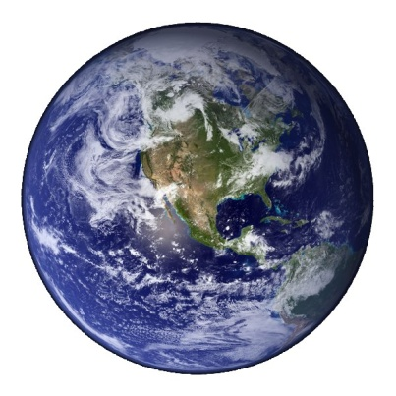
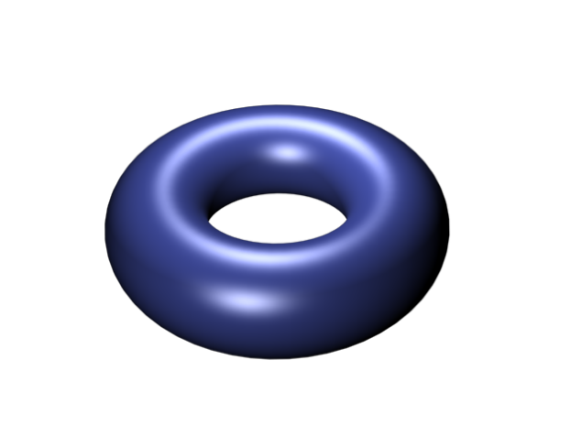

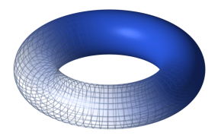
More Examples of Homology
H₀(X) counts the number of connected components
H₁(X) counts the number of distinct non-contractible loops
H₂(X) counts the distinct non-collapsible pockets
.
H₀(Sphere) = Z
H₁(Sphere) = 0
H₂(Sphere) = Z
H₀(Solid Ball) = Z
H₁(Solid Ball) = 0
H₂(Solid Ball) = 0
H₀(Two Tori) = Z x Z
H₁(Two Tori) = Z x Z x Z x Z
H₂(Two Tori) = Z x Z
H₀(Solid Torus) = Z
H₁(Solid Torus) = Z
H₂(Solid Torus) = 0

Slide 25
Geometry vs. Topology
Remember, in Topology we only care about objects & spaces up to homeomorphism; any stretching and bending is OK
Geometry is more rigid. There are lengths, angles, area, volume, curvature, etc.
Although topological invariants like homology are great, if we want to describe spaces even better we should look at their geometry

Slide 26
Onward to Orbifolds!
A symmetry is a continuous bijection that sends the points of a space to each other.
We’ll call a set of symmetries of a space a
group of symmetries if…
The set contains the identity i.e. the symmetry of sitting still
The set includes the inverse of each symmetry
The composition of two symmetries in the set is in the set (including repeating a single symmetry)

Slide 27
Orbit Spaces
The orbit of a point under a group of symmetries is the set of all points it can be sent to by an element of the group; an orbit it is a set consisting of a point and all its cousins.
An orbit space is a new space formed by choosing ONE point from every orbit to form an orbit space.
Only one point in each orbit can survive!!!
(The orbit space is the set of equivalence classes under the operation of the group)

Slide 28
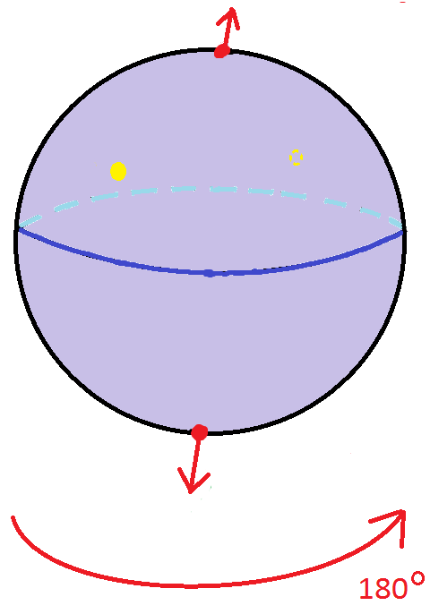
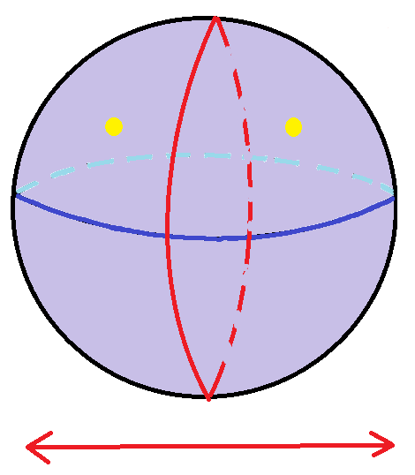
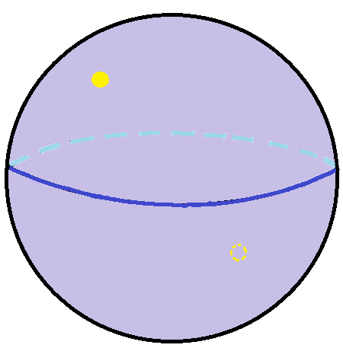
Quotients of the 2-sphere by symmetry groups with 2 elements
-1 | 0 | 0
0 | 1 | 0
0 | 0 | 1
-1 | 0 | 0
0 | -1 | 0
0 | 0 | 1
-1 | 0 | 0
0 | -1 | 0
0 | 0 | -1

Slide 29
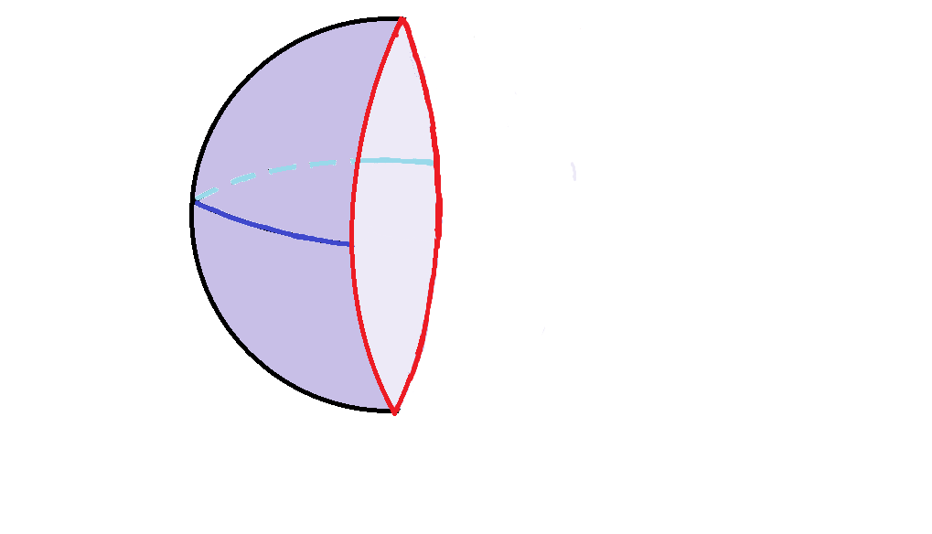
Quotients of the 2-sphere by Z₂
-1 | 0 | 0
0 | -1 | 0
0 | 0 | 1
-1 | 0 | 0
0 | -1 | 0
0 | 0 | -1

Slide 30
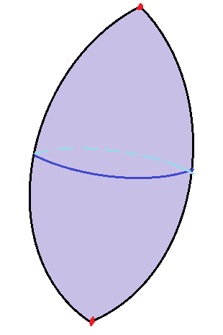
Quotients of the 2-sphere by Z₂
-1 | 0 | 0
0 | -1 | 0
0 | 0 | -1

Slide 31
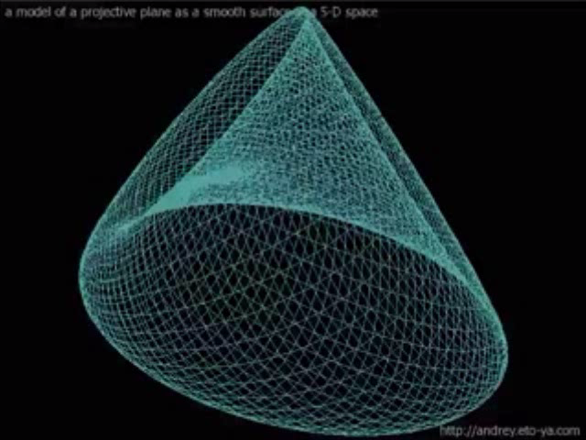
Quotients of the 2-sphere by Z₂

Slide 32
Recall….
H₀(X) counts the number of connected components
H₁(X) counts the number of distinct non-contractible loops
H₂(X) counts the distinct non-collapsible pockets
-1 | 0 | 0
0 | -1 | 0
0 | 0 | 1
H₀ = Z
H₁ = Z₂
H₂ = Z
H₀ = Z
H₁ = 0
H₂ = 0
-1 | 0 | 0
0 | 1 | 0
0 | 0 | 1
H₀ = Z
H₁= 0
H₂= Z
-1 | 0 | 0
0 | -1 | 0
0 | 0 | -1

Slide 33
Can we take orbit spaces of higher dimensional spheres?
Yes! To take a quotient of an n-sphere, you just need an orthonormal (n+1) × (n+1) matrix.
This will define a linear map that preserves distance from the origin, and thus sends points on the sphere to points on the sphere.
We can identify points that are mapped to each other (taking equivalence classes again) to get a quotient space

Slide 34
What if a group of symmetries generated by more than one symmetry?
No problem! For now, we will need to assume that all the generating symmetries in your group commute.
For example, imagine a 2-sphere with two different axes, one perpendicular to the ground and one parallel.
Lets rotate around each of these axes by 180°
(an action of Z₂ x Z₂)
The first rotation yields a football: North and South poles are singular (pointy). Rotating the football once again will result in two new singular points at the east and west. However, the north and south poles will be identified. The result is a 3-pointed triangular pillow .

Slide 35
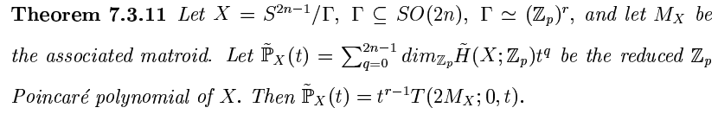
Can we predict the homology of a quotient based on the matrices that describes the generating symmetries?
Only one symmetry is required to generate the group, then we can (H. 2010) (cyclic group action)
If the symmetries for the group . (Swartz ’99)
(Elementary abelian p-group action)

Slide 36
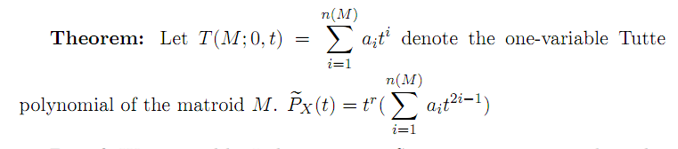
What if we quotient by a continuous rather than a discrete symmetry?
Imagine a globe designed to rotate on the earth’s axis. Now spin the globe fast. This displays an infinite group of rotational symmetries that sends any point on earth to every other point at the same lattitude. The circle is the group acting on the sphere.
The orbit space of this action would be one point for every line of lattitude.

Slide 37
Accreditations and recommended reading
Flatland, Edwin A. Abbot
Sphereland, Dionys Burger
The Shape of Space, Jeff Weeks
Clips:
Flatland: The Movie. Flat World Productions, 2007
Mobius Story: Wind and Mr.Ug by Vi Hart, www.vihart.com
Klein’s Bottle and Model of a Projective Plane videos produced for the topology seminar at the Leibniz Universitaet Hannover. Videos are available on youtube.com
This presentation is for educational use only.

